Slide 1
Welcome Freshmen! Class of 2028

Slide 2
Officer Walker
Current Issues on Campus
with Officer Walker!

Slide 3
Agenda
Officer Walker
Intro to Counseling Team
Counselor Contact Methods
Career Center
Graduation/College
Requirements
4 Year Plan
Impact Chandler Scholars
AZ Future Career Cluster Inventory
Personal / Emotional Support

Slide 4
Counseling Team
Ms. Spilsbury: A – Ce
Mr. Maluski: Ch - Ge
Mr. Snyder: Gi – Kn Get To Know Your
Mr. Dillon: Ko – Na Counselor!
Mr. Smith: Ne - Sh
Ms. Thompson: Si – Z
Mrs. Wargaski Social Worker
Mrs. Blancarte: Secretary

Slide 5
What are we here for? Where are we? How to make an appointment
We are here to help you academically, socially, emotionally, and guide you towards your future career and college experience.
We are located in the Administration building.
Counselors are available before school, after school, and during lunch without an appointment.
Appointments can be made with Mrs. Blancarte.
Opt into your counselor’s Google Classroom—if you are new send an email to your counselor to ensure you are invited. If you have not received an invite email your counselor to alert them.
Remember, no staff member receives emails to the GSE account; to correspond to any staff member lastname.firstname@cusd80.com
Basha webpage—Academics—Counseling Office—bookmark this and view every 2 weeks for updates—check out the Overview first please!

Slide 6
BASHA CAREER AND COLLEGE CENTER:
STAY INFORMED ABOUT:
Mrs. Fassinger – C106
Scholarships—join the Google Classroom
Enter Code: lrb5ua5 to join the classroom!
FAFSA
Jobs
Military
Volunteer Opportunities
College & Career Center Website
College & Career Center Padlet at:
https://padlet.com/fassingerrita1/basha-high-school-college-career-center-417il3xmdem9rc0g Join the Google Classroom
Classwork for BHS College/Career Center (google.com)
Sign in with your GSE Account.

Slide 7
Graduation Requirements
Curriculum area | Graduation Requirements | In-state University
English | 4 Credits | 4 Credits
Math | 4 Credits | 4 Credits
Lab Science | 3 Credits | 3 Credits
Social Studies | 3 Credits | 2 Credits
Career/Fine arts | 1 credit | 1 credit
Foreign Language | NONE | 2 Credits
PE | 1 Credit | 0 Credit
Health | 1/2 Credit | 0 credit
Required Courses | 16 ½ credits | 16 credits
Elective Courses | 5 ½ Credits | 0 Credits
Total Required Credits | 22 Credits | 16 Credits

Slide 8
Your GPA – Figure It Out
Step 1 – Assign a number to your letter grade
A = 4 D = 1 (Ouch!)
B = 3 F = 0 (Big Ouch!)
C = 2
***Most universities require unweighted GPA
Step 2 – Add up the “Grade Points”
Step 3 – Divide “Total Grade Points” by the number of classes taken.
Your GPA is the number you get after you divide “Grade Points” by the number of classes you have taken.

Slide 9
EXAMPLE
Classes | Grade | Grade Points
1. English 9 | A | 4
2. World History | B | 3
3. Math Year 1 | A | 4
4. P.E. | A | 4
5. Biology | C | 2
6. Spanish 1 | B | 3
 | Total | 20
 | GPA Grade points divided by # of classes 20/6 | 3.33

Slide 10
TRANSCRIPT
The student transcript may report both the weighted and unweighted
cumulative grade point average. The total number of grade points earned
in all courses taken is divided by the number of credits attempted.
Order your official transcript at www.parchment.com.
WHY SHOULD YOU TRY FOR A GOOD GPA????
* SCHOLARSHIPS $$$$$$$$
* ADMISSION TO COLLEGE

Slide 11
Graduation Honors
Cum Laude—meaning “with praise”. To qualify a student must achieve a 3.75-4.24 grade point average.
Magna Cum Laude—meaning “with great praise”. To qualify a student must achieve a 4.25-4.49 grade point average.
Summa Cum Laude—”with the highest praise”. To qualify a student must achieve a 4.5-5.0 grade point average.

Slide 12
Things To Remember
Grades start now!
Get to know your teachers and counselors, they will be able to help with your future!
Check with your teachers’ website and google classrooms for schedules.
All teachers provide tutoring if you need help before or after school. Link crew tutoring Mondays and Wednesdays all subjects F103. NHS tutors through Mr. Maluski A111.
Make smart choices in all aspects of your life.

Slide 13
WHAT IS ECAP?
●Education College and Career Action Plan
●Required for all Arizona students-Graduation Requirement
●Helps prepare students to reach their academic and career goals
Helps students explore
○Occupations
○Programs of Study
○College/University Information
○Resume Writing
○4 year plan

Slide 14
4 Year Plan
Login to your Infinite Campus Account
Click on “Academic Planner” on the left
Click on Next
We will work together to add classes for your sophomore, junior and senior years

Slide 15
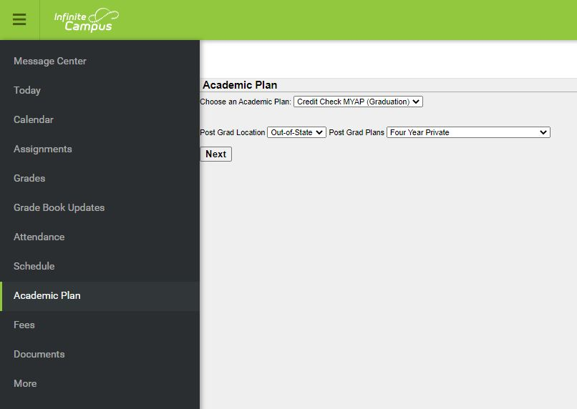

Slide 16
English Courses
Sophomore Year
AP English Seminar / Honors English 10
English 10
Honors English 10
Junior Year
English 11
AP English Language
EVIT English 11
Senior Year
English 12
College Prep English (Dual Enrollment)
AP English Literature
EVIT English 12
*Be sure to select both semester 1 and 2

Slide 19
Science Courses
Biology or Honors Biology
The following science courses can be taken after Biology:
Phenomena of Natural Science
Chemistry or Honors Chemistry
Physics or AP Physics 1
Biotechnology 1
The following science courses can be taken after Chemistry:
Human Biology
AP Biology – may be taken concurrently
Anatomy
AP Chemistry
AP Environmental Science
Any classes through Agriculture, talk to your counselor
***Be sure to select both semesters 1 and 2

Slide 21
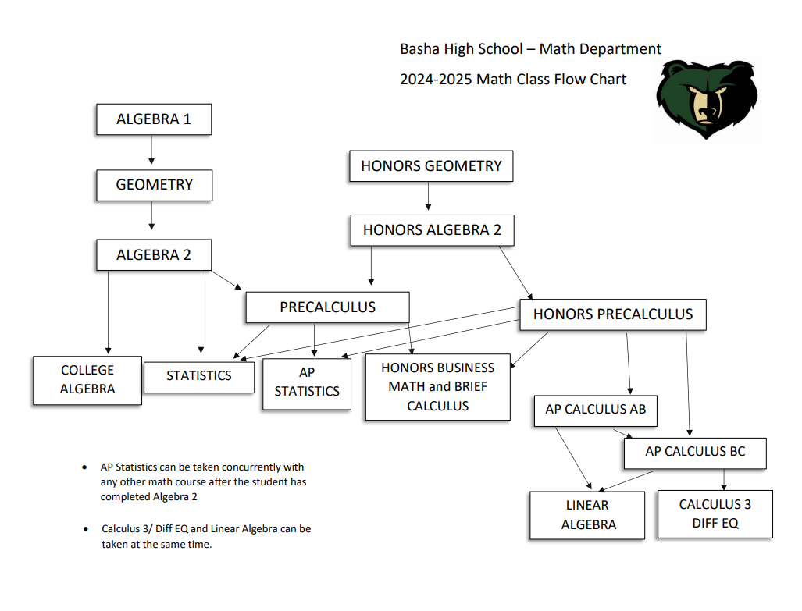

Slide 24
Social Studies Courses
Sophomore year – AP Human Geography as an elective
No required Social Studies course Sophomore year
Junior year
American/AZ History
AP American/AZ History
***Be sure to select both semesters 1 and 2
Senior Year
Government or AP Government
Economics or AP Macroeconomics

Slide 26
Electives or Other Required Classes
Choose electives for each year so that credits add up to 6
Don’t forget to select both semesters for year-long electives
Have you taken PE??? Health???
**If you are doing a summer school class or an online class- place in
year you plan to take the class.**
Once you have 22 credits entered, SAVE your work.

Slide 27
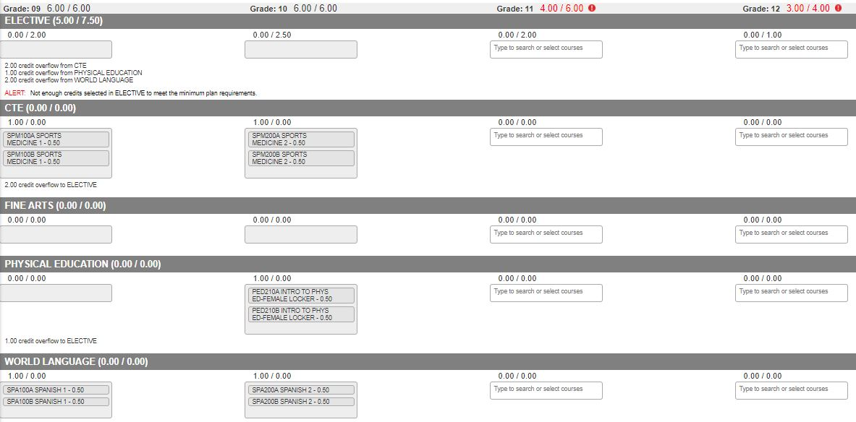

Slide 28
What is IMPACT?
IMPACT is a recognition program offered through Chandler Education Foundation with opportunities to apply for scholarship funding once qualifications are met.
Students who enroll in the ICS program commit to:
3.4 or higher cumulative GPA (assessed at the end of senior year)
95% or greater cumulative attendance
Completion of 100 hours of qualified community service.
You must opt in Freshman year
Hours must be submitted through Infinite Campus and approved by CEF.
Hours performed for the benefit of a religious organization are not eligible. Ex: Altar service, home visits for members, childcare, bible school/camp Service may be counted if an organization is performing an activity for the benefit of the greater community. Ex: food, clothing, or supply drive.

Slide 29
Opt-In During Freshman year
Step 1: Freshman logs into Infinite Campus account.
Step 2: Select [More] on the bottom left of the screen.
Step 3: Select [Impact Chandler Scholars] on the next menu.
Step 4: sign in with your CUSD address and password
Step 4: Complete Form and sign
Step 5: Check school email for confirmation.

Slide 30
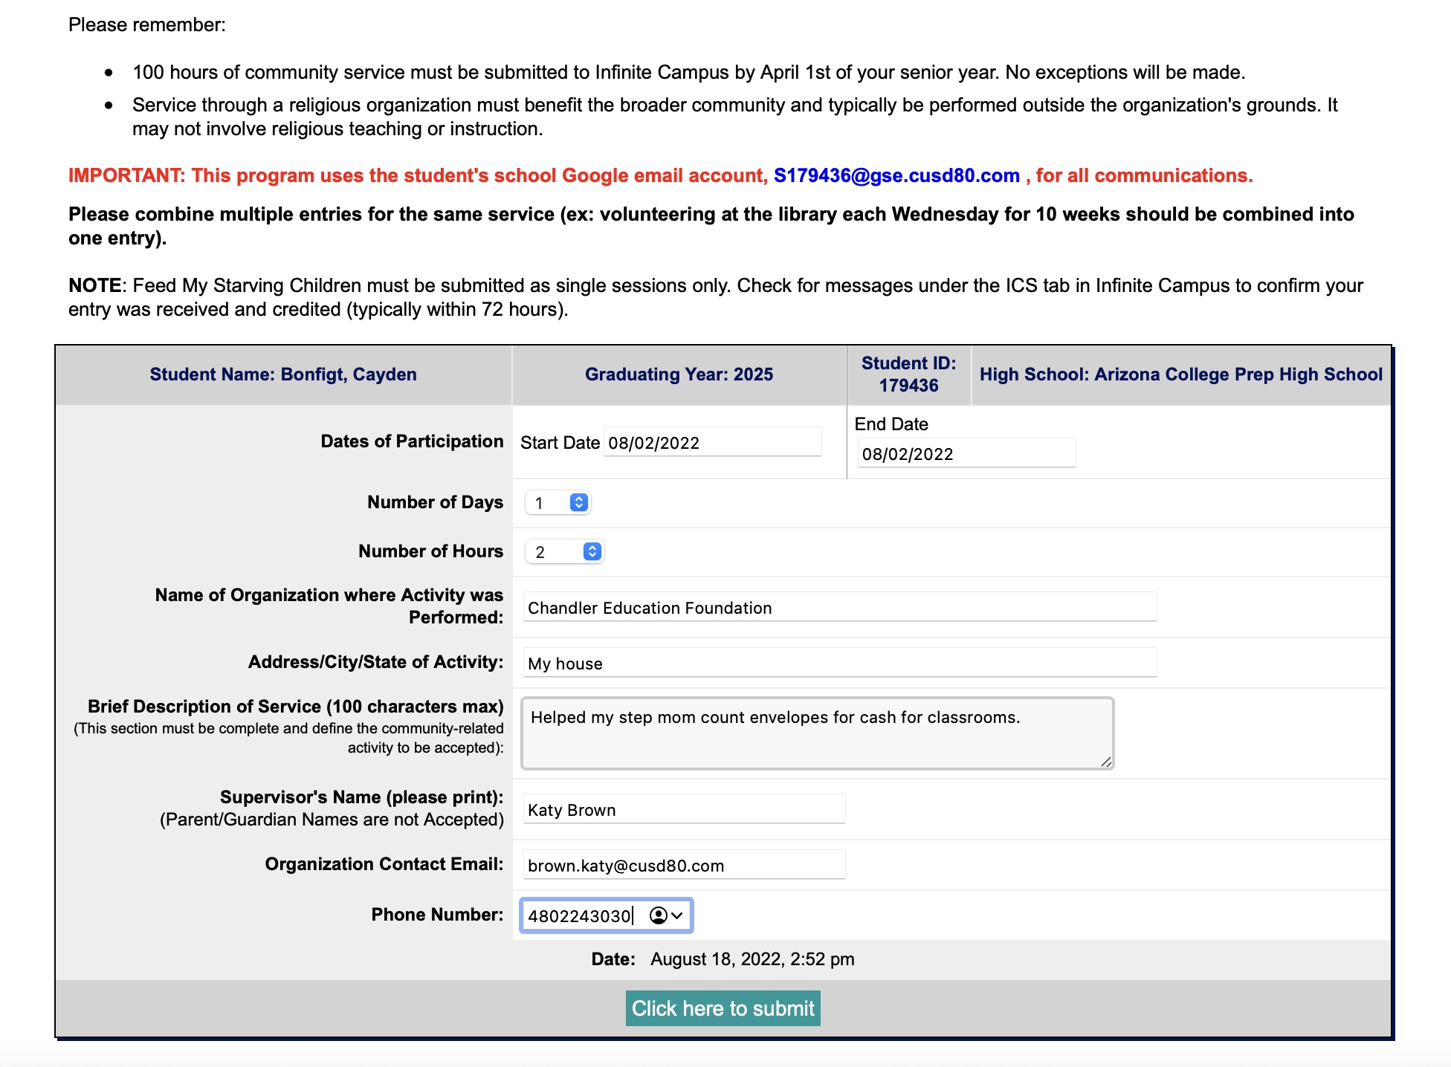
Submit Hours
Use the SAME link used to opt into IMPACT in Infinite Campus.
Submit once for multiple dates of service at the same location.
Check within 2 weeks to confirm hours were approved.
Eligible hours from 1st day of freshman year.

Slide 31
My Future AZ Instructions 1. Log into IC using your GSE login 2. Then you select CLEVER under MORE 3. Login to Clever with your GSE login 4. Go down to helpful links to My Future AZ

Slide 32
LET’S GET TO WORK!
You will see this when you first log in
Account Retrieval Email: Use your personal email if you have one, otherwise, leave this BLANK . DO NOT USE YOUR GSE email account!
Zipcode: Your personal zip code
Grade Level: current grade
Birth Date: enter your birthday
School: Put the name of the school you attended LAST year. When you get in to your account you can change the school.

Slide 33
TIME TO IDENTIFY YOUR INTERESTS
FIRST, CLICK ‘IDENTIFY YOUR INTERESTS’
NEXT, CLICK ‘TAKE CAREER INTERESTS QUIZ’

Slide 34
If you’ve already taken the quiz, hit retake. Your interests and results could have changed within the last year. If you can’t get in take drop down from career and take the quiz.

Slide 35
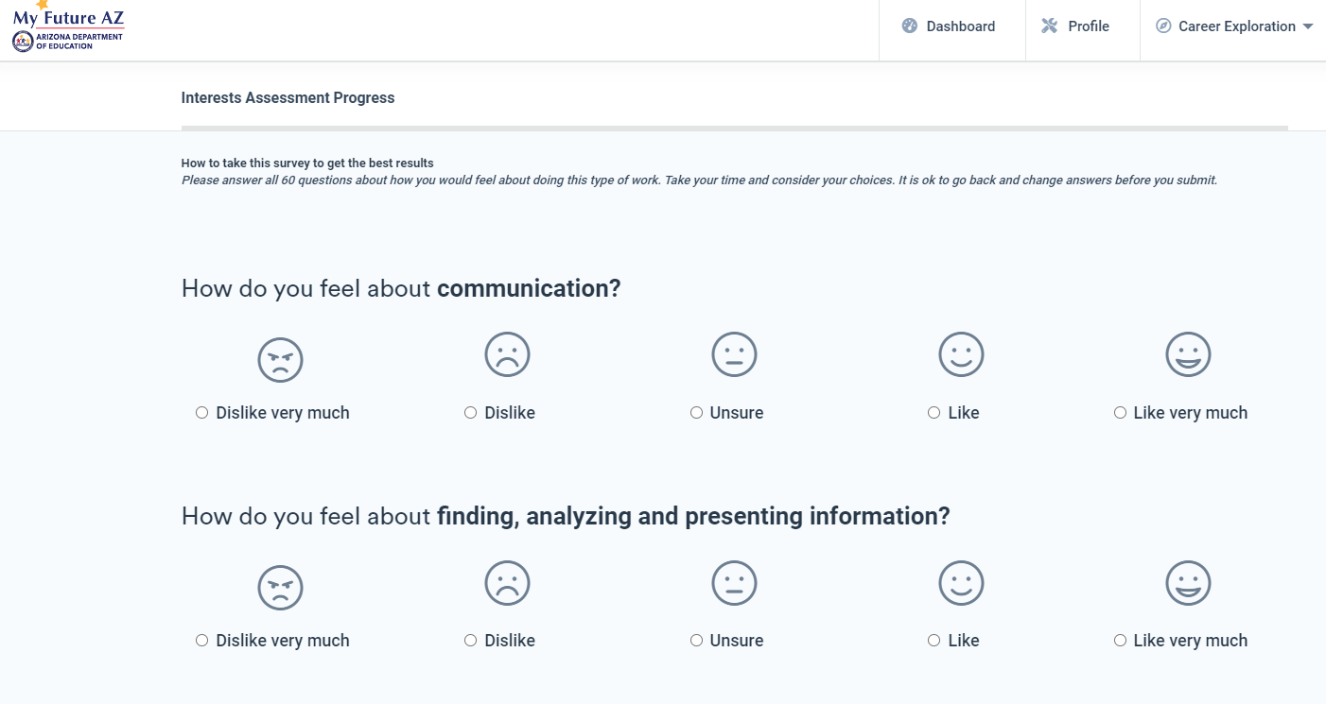
Read each sentence carefully and choose the emoji or word to indicate your interest in each statement

Slide 36
WHEN FINISHED...
01
THE SCREEN PICTURED WILL SHOW YOU YOUR TOP INDUSTRIES. INDUSTRIES ARE AREAS OF LIFE IN WHICH YOU MAY FIND A CAREER THAT WILL MATCH YOUR INTERESTS.
02
CLICK ‘SEARCH CAREERS WITHIN THIS INDUSTRY’ AND SAVE YOUR TOP THREE CAREERS BY CLICKING THE ‘HEART’ NEXT TO THE CAREER.
03
CLICK ON ‘VIEW CAREER’ TO LEARN MORE ABOUT THAT PARTICULAR CAREER.

Slide 37
it’s okay to not be okay
Notes:
Introduce topic of mental health and the importance of getting help for yourself or a friend who is struggling. Let students know that it is ok to not be ok, there is help available.
Explain the topics to be discussed:
A helpful app that is free for you to download.
The warning signs we should all look for- state them
Review Teenlifeline & 988 - mental health, safety concerns for yourself or someone else
Social Media and how that can affect our mental health
And then end with some additional resources when help is needed
Play video and discuss students’ initial thoughts. - How does this make them feel, what stood out to them, etc

Slide 38
A Friend Asks App
Get Help Now
How to Help a Friend
Warning Signs
Resources for Help
Notes:
A Friend Asks App is a free app you can use if you or a friend are struggling or at risk of suicide.
The Get Help Now icon is there if you need help immediately due to a emergency or crisis situation.
Another icon in the app is called “How to help a friend.” We want to focus on this area specifically today. This icon takes you into another page that has options of: warning signs, how to ask, what to do, and what not to do. We will be focusing on What to do.
We will also be reviewing warning signs to be aware of and end with resources that are available for you.
Review the What to do icon, this is important information for them to walk away with:1. Listen carefully - sometime just listening is so helpful, you don’t have to know what to say 2. let them know you care - be supportive and not judgemental 3. Take it SERIOUSLY - never assume your friend is joking, ask your friend directly if they are thinking about hurting or killing themselves 4. Seek help - Find a trusted adult you can ask for help (ask students who they could go to for help). Remind them that their school counselor, social worker, teacher are there to help. Specific resources shared at the end of presentation.

Slide 39
Warning Signs
Decline in school performance and behavior
Changes in school attendance
Talking, or joking, about suicide or making suicide threats
Loss of interest in things they used to enjoy
Unusual interest in death and dying
Taking unnecessary risks
Feelings of hopelessness
Depression
Bullying - Both the target of bullying and the bully are at risk
Change in Friendships - withdrawing from friends and social activities
Mood swings or personality changes
Increased use of alcohol or drugs
Giving away prized possessions
Changes in eating and sleeping habits
samsha.gov
Notes:
Four out of five individuals considering suicide give some sign of their intentions, either verbally or behaviorally.
Review Warning signs on slide
Highlight that this is not an all encompassing list. Encourage students to trust their gut when talking to their friends. If you are concerned about someone, take action - seek out an adult right away. When in doubt take action- it’s better to lose a friendship that lose a friend. When we take action we communicate that we care deeply about that friends well being.

Slide 40
988
988 offers 24/7 access to trained crisis counselors who can help people experiencing mental health-related distress. That could be:
Thoughts of suicide
Mental health or substance use crisis, or
Any other kind of emotional distress
People can call or text 988 or chat 988lifeline.org for themselves or if they are worried about a loved one who may need crisis support.
Notes:
988 is a new resource that you can call, text or chat if you or someone you know is having thoughts of suicide or experiencing a mental health crisis or substance use crisis.
988 connects you directly to free, confidential, and compassionate support. When you call, text or chat 988, you’ll be quickly connected to trained crisis counselors who will listen to your concerns, provide support, and connect you to additional resources if needed. You can chat at 988lifeline.org.

Slide 41
Effects of Social Media
Teen Voices
Notes:
Show Teen Voices video. Explain that what they see on social media is not necessarily true of what is happening in a person’s life. Ask for examples (families that look “Perfect” but are actually struggling, filters used to look better, posting pictures with friends when they actually feel very alone) This would be a great opportunity to point out the stat saying that 54% of teens fear that their friends are having more fun than them.
Discuss some of the statistics in the graphics. The image on the left gives great information regarding how attached teens are to their phones - using it before bed and as soon as they get up.
Blue graphic on the right - great stats on how their thoughts about their appearance can be negatively altered based on social media.
Ask students to share how they feel that social media has impacted their lives (distracted from studying, spend more time alone and less with friends/family, increases arguments with parents/guardians, etc). Ask students if they have ever taken time away from their phones and what that felt like, how did it impact their life?

Slide 42
Additional Resources
911
988
Teen Lifeline 602-248-TEEN (8336)
Text Crisis Line 741-741
Suicide Prevention Lifeline 800-273-TALK (8255)
EMPACT 480-784-1500
Trevor Project LGBTQIA+ 1 866 488-7386
A Friend Asks App
Notes:
As discussed in the previous slides, sometimes concerns are too big and need additional outside support from a trusted adult. A trusted adult can be a parent, family member, school counselor, coach, teacher, social worker, mentor, or other adult you feel safe speaking to.
EXPLAIN school procedure here for scheduling an appointment with a school counselor or social worker on your campus.
Other resources off campus include these on the slide. In an immediate emergency, always call 911. The other numbers listed can assist if you or someone you know need help. 988- we already discussed that today. You can call, text or chat with trained crisis counselors if you, or someone you know, is experiencing a mental health crisis or having thoughts of suicide. Teenlife Line is another resource. This number is also on the back of your student identification. Some of you may remember that Teen Lifeline was present at Link Crew Day and provided information regarding Teen Lifeline and what it is like to call the phone number. Teen Lifeline is a FREE RESOURCE. Suicide prevention hotline/EMPACT is another resource available to you. And, lastly, A Friend Asks App which we already discussed in detail.
***Students could be allowed to take out cell phones to enter phone numbers into contacts. Encourage students to take minute to download the A Friend Asks App. Discuss that all of these are FREE resources.
If after listening to this presentation you would like to speak to a counselor please (EXPLAIN procedure for following up with students that day and the location for finding a counselor.)

Slide 43
WE ARE ALWAYS HERE FOR YOU! FINISH STRONG!

